Slide 1
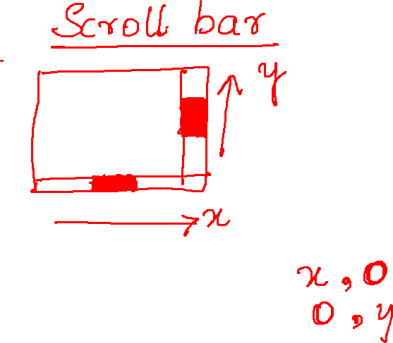

Slide 2
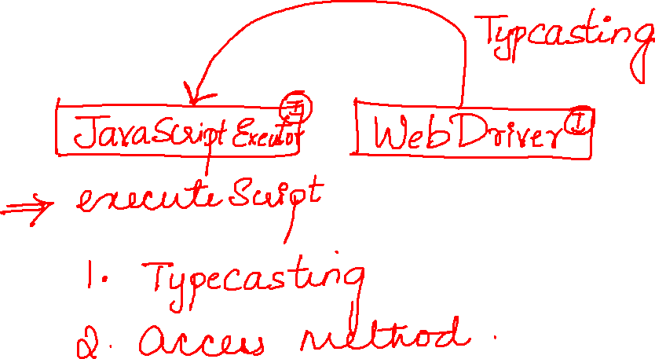

Slide 3
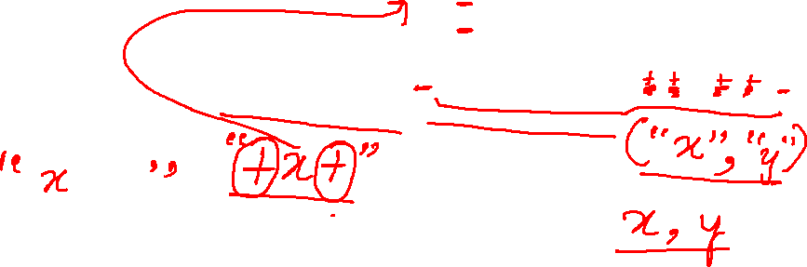
Point loc = ele.getLocation(); int x=loc.getX(); int y=loc.getY(); JavascriptExecutor js=(JavascriptExecutor) driver; js.executeScript("window.scrollBy("+x+","+y+")");

Slide 4
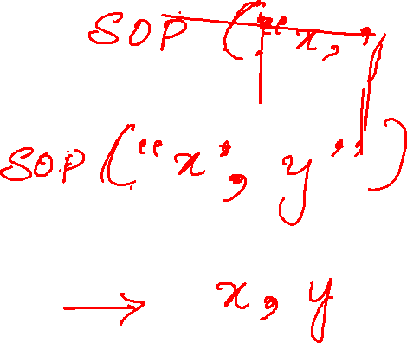

Slide 6


Slide 7
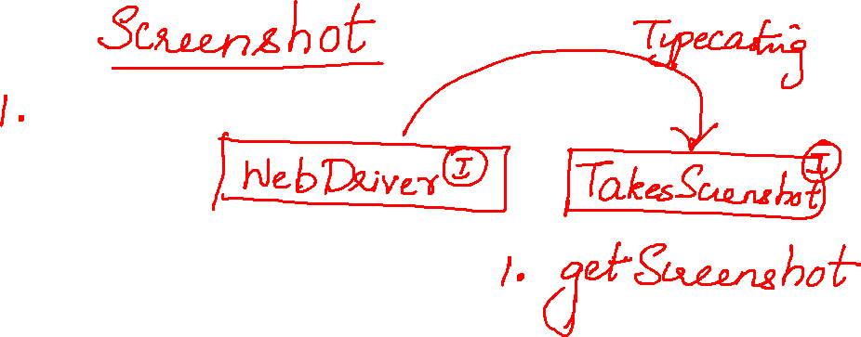
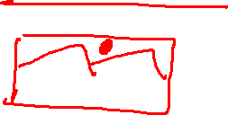

Slide 8
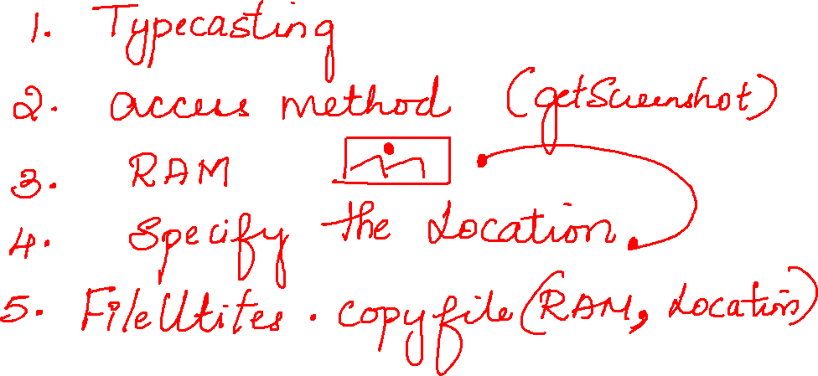

Slide 9
